Slide 1

End of Semester Presentation – Summer’13
Upsham Dawra, Sindhu Satish

Slide 2
Agenda
Project Overview
Team and stakeholders
Context
Spring to Summer- Where we were and what we accomplished so far
GizmoE Architecture & Design- what we did
Deliverables & Implementation Status
Task Composition Language
Demo
Process- how we did
Plans and operations
Progress and challenges
Demonstration and results
Metrics
Risks & Quality Assurance
Reflections

Slide 3


Team
Intro
What we did
How we did
Reflections
Sindhu Satish
Bachelors in Computer Science And Engineering
Interested in learning how to effectively transform Business goals into technical requirements through structured techniques
Upsham Dawra
Computer Engineering, Purdue University 2012
Interested in formal logic, operating systems and machine learning

Slide 4

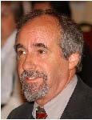


Stakeholders
Intro
What we did
How we did
Reflections
Clients
David Garlan
Bradley Schmerl
Researchers with vision of extendable system allowing task composition by remote educators
Mentor – Daniel Plakosh
Robotics Group
Manuela Veloso
Interested in novel use of the Cobot3

Slide 5
What is GizmoE?
Intro
What we did
How we did
Reflections
GizmoE is a system developed for executing tasks remotely that are composed by users- provides a rich telepresence experience
A task is a unit of work that can be executed by the system. It can be composed of other tasks/capabilities.
Examples- Attend classes virtually, Give lectures, Meet advisor, etc
A capability is the actual java class created by a capability developer
Smallest unit of work
Examples- Go to room, Start Skype session, etc.
Tasks are executed by the system by using various resources like, CoBot3 (robot), Google Calendar, Skype, etc.
GizmoE executes tasks that follow semantics of the language and provides user defined error-handling
Implemented to be easily transformed to a web application with an operational GUI
It also provides API’s that guides a developer to develop capabilities that make up a task
Notes:
P
----- Meeting Notes (8/5/13 09:22) -----
Task meaning
Correctness

Slide 6






System Context
Intro
What we did
How we did
Reflections
Educator
System Resources
GizmoE System
Legend
Uses
Composes and/or executes tasks
Capability Developer
Develops Capabilities
Notes:
Change arrows

Slide 7
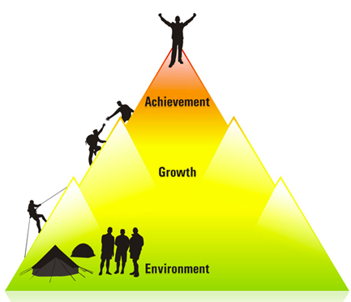
Spring to Summer- Achievements

Slide 8
From Spring to Summer
Intro
What we did
How we did
Reflections
By the end of Spring we had-
Analyzed the Gizmo system and concluded that it doesn’t meet client’s needs at design-level
Proposed a set of probable requirements and prototypes to the clients
Designed the first version of system architecture
By the end of Summer we have-
Finalized requirements
Conducted formal architecture
review with clients and finalized
the design
Developed capabilities and tasks for
the system
Implemented task system that met
all requirements
Delivered a functional system
Notes:
Analysis on gizmo system…cannot use it….proposed requireemnts…draft version
GizmoE = 576, Gizmo = 2880
Finalized req…finalised arch…implesemnt arch…implement system and delivverd
change it to first graph

Slide 9

Architecture & Design

Slide 10
System Requirements
Intro
What we did
How we did
Reflections
Tasks that are sequential, parallel and a combination of both should be executed by the system
The system should be able to catch user defined errors
The system should be able to handle CoBot specific functions defined by the user like monitoring the battery capacity and killing all flows of execution on low battery
The system should support (provide prompts to) custom user-defined input
The system should have the ability to re-compose tasks
The system should have the ability to allow developers to easily add new capabilities
Notes:
MVC part?
Deliverables for system
Ability to define custom errors-cap developers
Catch errors…
Custom errors
Requirements for system

Slide 11
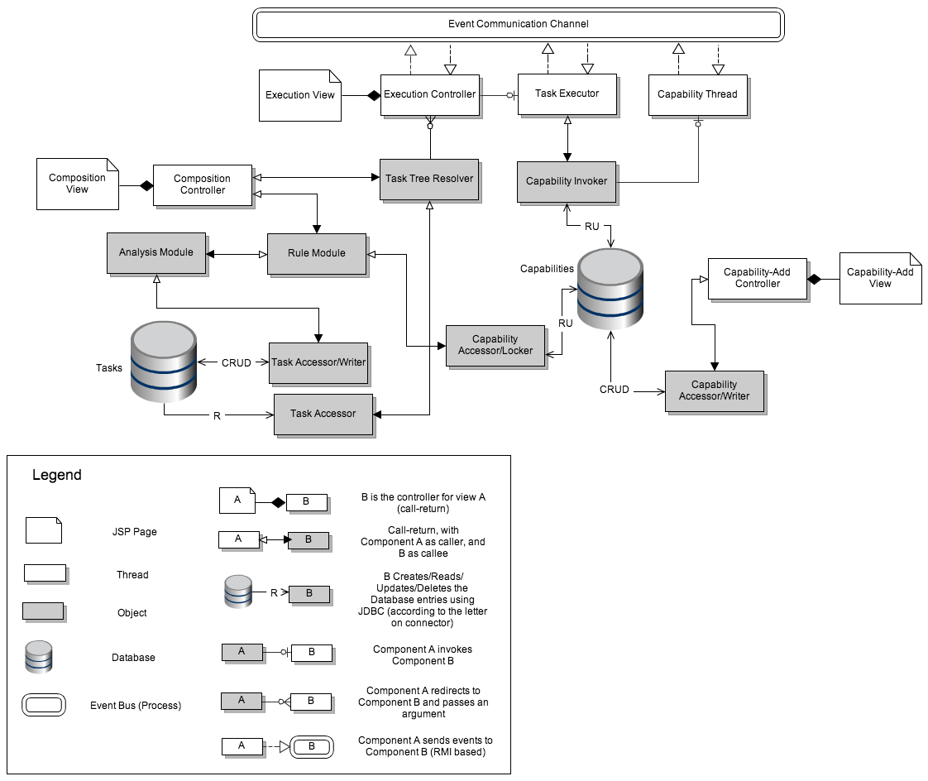
Overall System Architecture
Intro
What we did
How we did
Reflections
Legend
Task Composition
Capability Addition
Capability Addition
Task Execution

Slide 12
Design Implementation Details
Intro
What we did
How we did
Reflections
Task Composition Part
Built the Task Tree Resolver, Task Executor, Capability Spawner, Capabilities & Tasks, Communication Channels
Capability Addition Part
Developed API’s for creating & adding Capabilities to the system
Simplifications made to the system
Created packages to store task XMLs, capability config files instead of actual databases
Built most (not all) features of the Analysis Module into the Task Tree Resolver for a comprehensive and meaningful execution of tasks
Kept CoBot3 out of the system context to be used as a resource
Notes:
MVC part?

Slide 13
Task Composition Language
Intro
What we did
How we did
Reflections
TCL is designed mainly to fulfill the composability scenario
TCL should allow a user to use existing set of tasks/capabilities to define a new task without any capability-specific language or expertise
TCL should allow user to compose different work flow patterns; primarily, sequential, parallel, parallel within sequential and sequential within parallel patterns
TCL should allow user to define custom errors (for error handling) through “mapping modes”
TCL should allow user to define custom inputs
TCL has two aspects- execution flow and data flow
Ability to define and add new data flow “modes” to the language should be supported by the system
Notes:
Composability scenario? QAS06
Designed for user defined error handling – through mapping modes
Make two slides
Split data flow and execution flow- to have two aspects..execution and data
Custom user input
Ability to add data flow modes on the fly
Talsk about all modes
Error- error flows
Stop- flow only st\op by killing all
overall

Slide 14
Task Composition Language
Intro
What we did
How we did
Reflections
Syntax of the TCL contains 4 main sections:
Inputs- Defines overall inputs for the task
Outputs- Defines overall outputs for the task
Special output groups have been designed to collect similar outputs separately. Examples: Success, error
Control- Defines actual workflow of the task for execution
sequential & parallel
Data- Defines input and output mapping within task (data flows)
Special mapping modes have been pre-defined for the system such as:
Copy- sends overall inputs of tasks to capabilities
Pipe- sends outputs from one capability as input to another capability
Stop- disables or kills all other data flows other than itself
Error- routes outputs to the error flows
Notes:
Composability scenario? QAS06
Designed for user defined error handling – through mapping modes
Make two slides
Split data flow and execution flow- to have two aspects..execution and data
Custom user input
Ability to add data flow modes on the fly
Talsk about all modes
Error- error flows
Stop- flow only st\op by killing all
overall

Slide 15
Sample Task XML- I/O
Intro
What we did
How we did
Reflections
<?xml version="1.0"?>
<task name="Find Advisor Task">
<!-- inputs to the task -->
<inputs>
<input name="AdvisorName" type="String"/>
</inputs>
<outputs>
<outputGroup status="error”>
<output name="AdvisorNotFound" type="Boolean"/>
<output name="AdvisorNotFree" type="Boolean"/>
<output name="AdvisorPhotoNotAvailable" type="Boolean"/>
</outputGroup>
</outputs>
Shows how the inputs and outputs are defined for the task “Find Advisor Task”
Notes:
MVC part?

Slide 16
Sample Task XML- Control/Data
Intro
What we did
How we know
Future Steps
<control>
<flow type="sequence">
<step name="FindIfKnown" id="2"/>
<flow type="parallel">
<step name="SeeAppearance" id="3"/>
<step name="GoTalkToPerson" id="4"/>
</flow>
</flow>
</control>
Shows the workflow defined by the user
<data>
<mapping mode="copy">
<source name = "AdvisorName"/>
<target ref="2" name="PersonName"/>
</mapping>
<mapping mode="pipe">
<source ref="2" name="CurrentLocation"/>
<target ref="4" name="location" />
</mapping>
Shows the input/output mapping through use of modes
Notes:
MVC part?
----- Meeting Notes (8/5/13 09:22) -----
Based on requirements of clients for parallel tasks and sequential tasks...

Slide 17

Project Demo

Slide 18
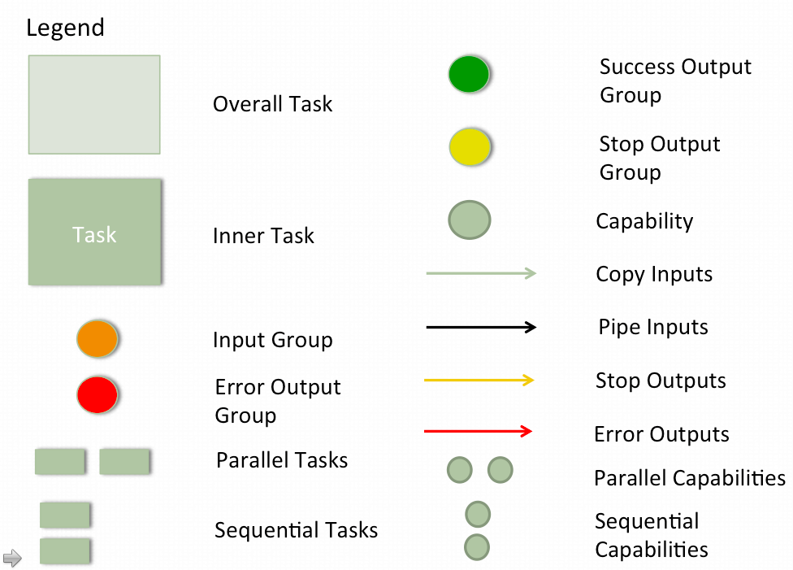
Meet Advisor with Battery Task
Intro
What we did
How we did
Reflections
MeetAdvisorWith
BatteryTask
BatteryCapacity (input)
AdvisorName (input)
BatteryMonitorTask
MeetAdvisor
Task
BatteryLow (output)
Advisor NotFree (output)
AdvisorPhoto NotAvailable (output)
Advisor NotFound (output)
Notes:
----- Meeting Notes (8/5/13 09:22) -----
Parathenthesis input

Slide 19
Meet Advisor with Battery Task
Intro
What we did
How we did
Reflections
BatteryMonitor
Task
BatteryCapacity
(input)
BatteryMonitor
Capability
GoToLocation
Capability
Location = home
(input)

Slide 20
Meet Advisor with Battery Task
Intro
What we did
How we did
Reflections
MeetAdvisorTask
AdvisorName
(input)
FindIf
Known
Task
CurrentLocation (piped input)
AdvisorName (input)
AdvisorName (input)
SeeAppearance
Task
GoTalkTo
Person
Task
AdvisorNot
Found (output)
AdvisorNot Free (output)
PhotoNotFound (output)
Notes:
Check xml

Slide 21
Meet Advisor with Battery Task
Intro
What we did
How we did
Reflections
FindIfKnownTask
Name (input)
LookUpEmail
Capability
EmailAddress
(piped input)
NotFound (output)
FindBusy
Capability
CurrentLocation
(output)
NotAvailable (output)

Slide 22
Meet Advisor with Battery Task
Intro
What we did
How we did
Reflections
SeeAppearance
Task
Name (input)
LookUpPhoto
Capability
DisplayPhoto
Capability
Photo (piped input)
PhotoNotFound (output)

Slide 23
Meet Advisor with Battery Task
Intro
What we did
How we did
Reflections
GoTalkToPerson
Task
Location (input)
GoToLocation
Capability
PersonName (input)
EmailAddress (input)
SkypeWith
PersonCapability

Slide 24
Meet Advisor Task
Intro
What we did
How we did
Reflections
Task resolved by system
Legend
LookUpEmail
Capability
Capabilities
FindBusy
Capability
Execution flow within
task
Starting execution flow
LookUpPhoto
Capability
GoToLocation
Capability
Task endings
DisplayPhoto
Capability
SkypeWith
PersonCapability
Notes:
Remove all inputs and out

Slide 25
Meet Advisor with Battery Task
Intro
What we did
How we did
Reflections
Task resolved by system
Legend
BatteryMonitor
Capability
LookUpEmail
Capability
Capabilities
FindBusy
Capability
Execution flow within
task
GoToLocation
Capability
Starting execution flow
LookUpPhoto
Capability
GoToLocation
Capability
Task endings
DisplayPhoto
Capability
SkypeWith
PersonCapability
MeetAdvisor
Task
Notes:
Remove all inputs and out

Slide 26
Demo
Intro
What we did
How we did
Reflections
Let’s cut over to the Demo Video now…
Notes:
PLAY DEMO VIDEO!

Slide 27
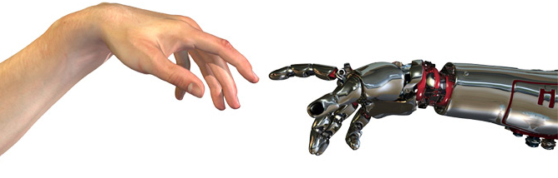
Process and Tracking

Slide 28
Plan of Action
Intro
What we did
How we did
Reflections
Review and finalize system architecture with clients
Estimate time and resources required to develop the entire system using function point analysis
Calculated 166 FPs, considering a conversion factor of 53 SLOC/FP we estimated the size of system ~8798 SLOC
Used previous team’s SLOC efficiency to estimate how much we can deliver- less than 40% of the system
Negotiated delivery items with clients
Design a Task Composition Language
Develop Task Executor and a basic Analysis Module- to demonstrate task execution
Develop simple capabilities on CoBot- to demonstrate execution of a simple task on CoBot

Slide 29
Initial Milestone Plan
Intro
What we did
How we did
Reflections
Architecture Changes
Task Composition Language (XML)
Task Dag
Resolver
Workable
Task System
Documentation
May 21
June 4
June 18
July 23
August 6
May 28
June 11
July 2
July 30
Plan & Architecture Review
Task Dag Implementation
Analysis Module & Task Executor
Capabilities/Tasks on CoBot
Legend
Week (Tuesday through Tuesday)
Beginning of week
Milestone Met
Milestone Missed
Milestone Not Yet Reached
Same color indicates
related tasks
Different color indicates
different tasks

Slide 30
Initial Development Process
Intro
What we did
How we did
Reflections
Process followed after architecture design
Borrows heavily from Scrum, tailoring of our Spring process
Instead of a consistent product backlog, lay out a high-level deliverables backlog
Clients could factor in new features due to complexities in the project goals
Short week-to-week cycle instead of longer periods
Focus mostly on developing code (due to large size of system)
Highly risk-driven
Continually update risk list, act on risks, use them to drive client discussions
Detail Design
Create Dev tests
Execute Dev tests
Fix defects caught in Dev tests
Write Code
Promote to Master branch

Slide 31
Process – How?
Intro
What we did
How we did
Reflections
Breakdown the deliverable into tasks, and estimate right after client meeting
Assign tasks, track progress
Daily progress meetings within team
Formal standup ->
Status Email -> Status over phone
If not on track or facing issues, inform
clients beforehand
Open channel of communication over email
Meet day-before-meeting, finalize deliverable, spend some time on process
Set expectations for meeting beforehand over email
15-minute open time to talk about current cycle and suggestions
Update risk list, see what’s ‘bubbling up’
5%
46%
22%
10%
17%

Slide 32
Earned Value
Intro
What we did
How we did
Reflections
Trouble achieving planned value!!
June 18th missed milestone
Notes:
Change type 2D

Slide 33
Planned vs Actual Time- Initial
Intro
What we did
How we did
Reflections
Spending more than planned time!!
June 18th missed milestone
Notes:
Change type 2D

Slide 34
Re-evaluation of Plan
Intro
What we did
How we did
Reflections
Due to the size & complexity of the system, small team size and varied technical expertise of the team, we monitored the developmental progress closely
Issues in the development process & plan:
Maximum efficiency of team not achieved
SLOC is not a good measure for determining team efficiency and work produced (earned value)
Key design decisions and assumptions in the code was being lost
Good documentation of code was missing- only had basic comments
Unable to focus on quality

Slide 35
Get Well Plan
Intro
What we did
How we did
Reflections
Goal:
Achieve 90+% of planned value
Develop good quality code
with appropriate documentation
Take advantage of team’s strengths
Strategy:
Perform code reviews- to capture assumptions and errors
Include code documentation and other supporting documentation produced along with SLOC as a measure of earned value
Use current data to re-estimate and negotiate deliverables with clients
Review progress regularly
5%
30%
15%
12%
21%
17%

Slide 36
Plan After Re-Evaluation
Intro
What we did
How we did
Reflections
Architecture Changes
Task Composition Language (XML)
Task DAG Resolver
Task Executor
(Create)
Task Executor (Display)
Task Executor (Integrate)
May 21
June 4
June 18
July 2
July 16
July 30
May 28
June 11
June 25
July 9
July 23
August 6
Plan & Architecture Acceptance
Task DAG Implementation
Scope
Change/Documentation
Task Executor (Manage)
Task Executor (Communicate)
Demo with UI
Legend
Week (Tuesday through Tuesday)
Beginning of week
Milestone Met
Milestone Missed
Milestone Not Yet Reached
Same color indicates
related tasks
Different color indicates
different tasks
Notes:
Talk about time covered scope chache

Slide 37
New Development Process
Intro
What we did
How we did
Reflections
Detail Design
Process followed after architecture design
Design review with clients
Legend
Write Code
Document detail design
Write Unit tests
Sequential Activities
Execute unit tests
Code Review
Parallel Activities
Fix defects
Document code & assumptions
Activity Flow
Promote to Master
Walkthrough code /demo
Review documents with clients
Notes:
----- Meeting Notes (8/5/13 09:22) -----
Scrum….
Iterative….

Slide 38
Earned Value
Intro
What we did
How we did
Reflections
Under new process
and after scope change
June 18th missed milestone

Slide 39
Planned vs Actual Time Spent
Intro
What we did
How we did
Reflections
Under new process
and after scope change
+7%
June 18th missed milestone

Slide 40
Top 3 Current Risks
Intro
What we did
How we did
Reflections
Risk Condition | Risk Consequence | Risk Strategy | Mitigation Plan
Team may spend a significant amount of time while working with CoBot | Compromise will be made on time spent in developing task execution for tele-presence, which is the main focus of the system | Mitigate | Communicate with clients regarding the complexities involved in working with CoBot by reminding them the experience of previous MSE team
Projected estimates of team efficiency may not be correct | Client may expect team to deliver according to projections made | Mitigate | Continuously keep track of the estimates and make the Clients aware of it
Team may not be able to identify and utilize team resources to maximum | Team will fall short in delivering and may not succeed | Mitigate | Quickly identify with the help of project mentor what each member is good at and allocate responsibilities
Notes:
Upsham, you had some better ideas
Put on top and focus

Slide 41
Risk Analysis
Intro
What we did
How we did
Reflections
Risks
Technology
Requirements
Scope
Resources
Sources of Risks
Risks that turned into problems = 2
Time spent on Risk Management = 4%
1
Open
4 Monitor
31
Total
27 Closed
Notes:
Monitor-two more documents…
Open- team after us may not understand
Not done
2 –team expertise and last time
5%
----- Meeting Notes (8/8/13 21:10) -----
Team

Slide 42
Quality Plan- New
Intro
What we did
How we did
Reflections
Estimates show that we cannot spend 46% of the time on quality- Clients agreed
Since our project might be taken for future developments, we planned to have:
Good documentation of code- Highlighting plug points, assumptions, complexities, justifications
Good documentation of underlying design decisions in the implementation aligning well with the main architecture design
Thorough weekly code reviews within the team to capture defects and assumptions
Weekly walkthroughs with the client to capture missing features and anomalies

Slide 43
Quality Plan- Testing
Intro
What we did
How we did
Reflections
First performed basic dev tests on code modules
Developed catch-all test cases to perform Junit tests
Since development was done bottom-up, each major module was integrated with the new module developed and tested with the designed test cases (integration testing)
Also developed sensible test cases (Meet Advisor) to make demonstration meaningful
Goal- 90% statement & 80% branch coverage
Achieved- 94% statement and 90% branch coverage
Notes:
----- Meeting Notes (8/8/13 21:20) -----
unit testing mention

Slide 44

Reflections

Slide 45
What Went Wrong?
Intro
What we did
How we did
Reflections
Should have recognized varied team expertise right while planning for Summer, instead, we we tried to please clients through an ambitious plan
Should have realized documentation was important right at the beginning, especially after learning from previous team’s experience
Should have realized the problems we could face going forward with a legacy system and leveraged Gizmo team’s expertise while they were present
Could not decompose implementation tasks for a small number of modules well

Slide 46
What Went Right?
Intro
What we did
How we did
Reflections
Iterating on previous team’s experience helped in avoiding repeating mistakes and building the “product right” (verification)
Continuous tracking and monitoring earned value and time estimates helped in identifying issues early
Constantly leveraging client’s technical expertise helped in building the “right product” (validation)
Risk management helped us identify one of the major risks that could have turned into a big problem (working with Cobot)

Slide 47
Lessons Learnt
Intro
What we did
How we did
Reflections
In a research based project, a traditional software engineering process may not be appropriate
However, tailoring a process will really help tracking and monitoring a research based project
When inheriting a legacy system for further development, always dedicate time (even if its significant) to thoroughly understand it
Although, at first it seemed like we were spending significant amount of time on legacy system analysis, it helped both us and the clients to learn a lot and reach the goal quicker

Slide 48

Questions?

Slide 49

Backup

Slide 50
Architectural Drivers
Functional requirements
Sequential and Parallel task execution, with correct I/O
‘Meaningful’ task composition (Type-checking)
Interruptible tasks
Addition of capabilities possible by developer
Quality Attributes
Reliability – Error handling (Ability to inform the user in case of a failure)
Runtime Extensibility – Ability to add capabilities while system is running
Static reusability and extensibility – Code framework to easily add new capabilities to the system
Performance – Response time for composition and execution should not be unreasonable

Slide 51
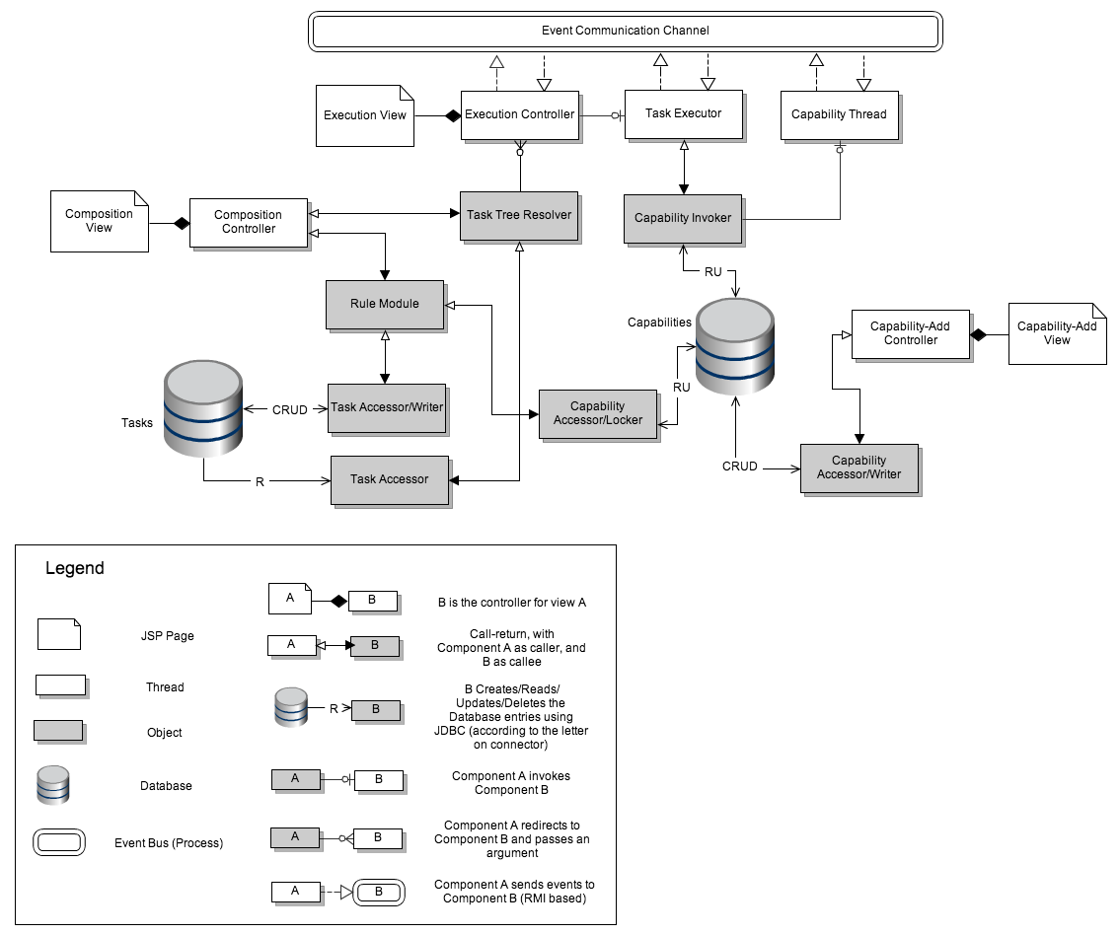
Architecture – Dynamic View
Overall Architecture – Dynamic View

Slide 52
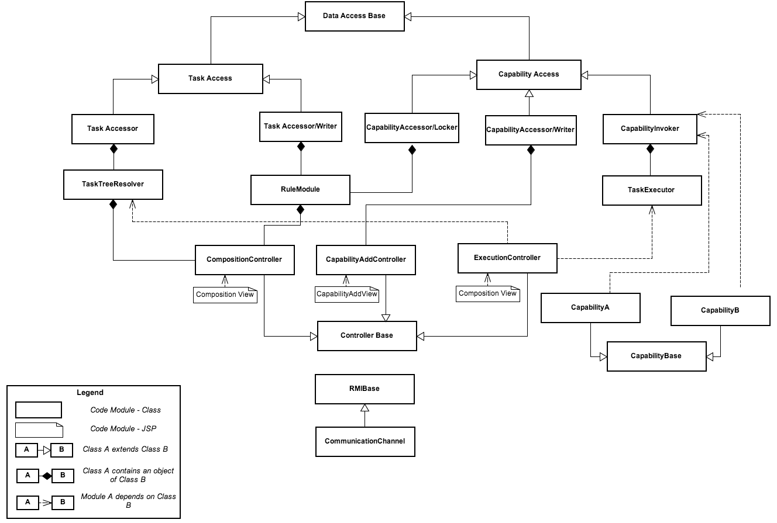
Architecture – Static View
Overall Architecture – Static View

Slide 53
Legend
Capability
Task
I/O to component
Task composed by user

Slide 54
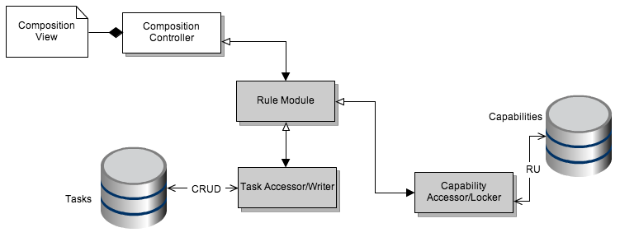
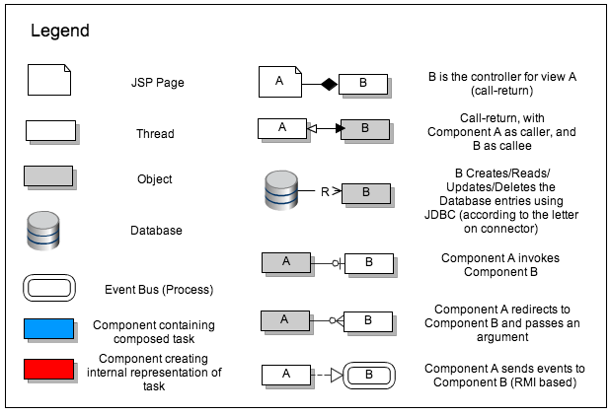

Slide 55
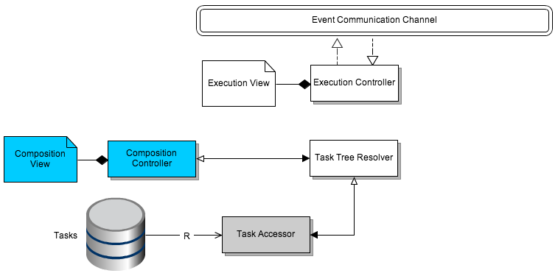

Slide 56
Legend
Executed Capability
Currently Executing
Capability
To Be Executed
Capability
Already Executed
I/O to capability
Currently Executing
I/O to capability
To Be Executed
I/O to capability
Overall Input
Task resolved by system
Overall Output

Slide 57
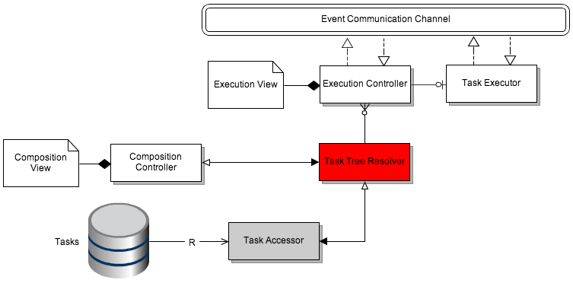
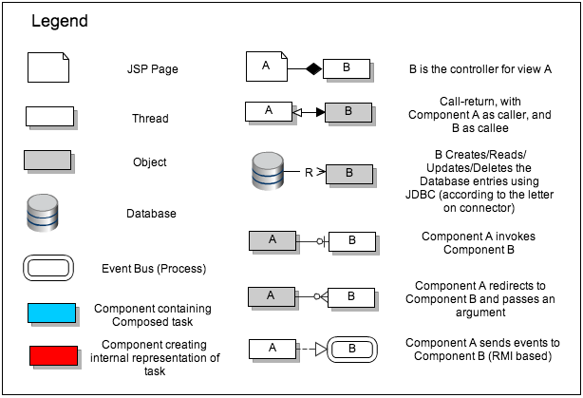

Slide 58
Legend
Executed Capability
Currently Executing
Capability
To Be Executed
Capability
Already Executed
I/O to capability
Currently Executing
I/O to capability
To Be Executed
I/O to capability
Overall Input
Sequential Execution
Overall Output

Slide 59
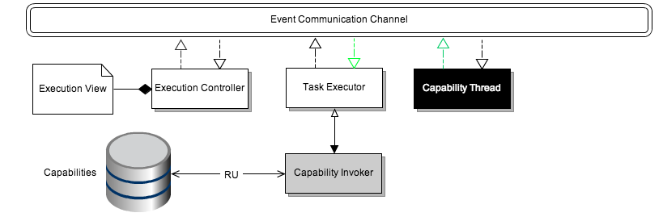
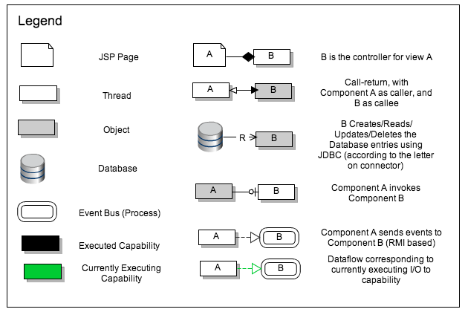

Slide 60
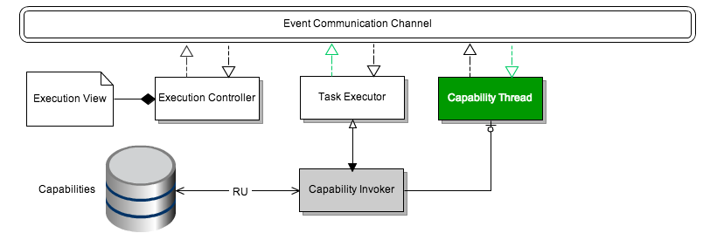

Slide 61
Legend
Executed Capability
Currently Executing
Capability
To Be Executed
Capability
Already Executed
I/O to capability
Currently Executing
I/O to capability
To Be Executed
I/O to capability
Overall Input
Parallel Execution
Overall Output

Slide 62
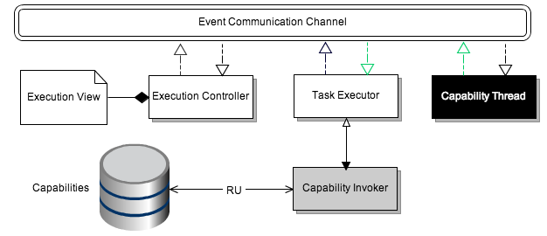

Slide 63
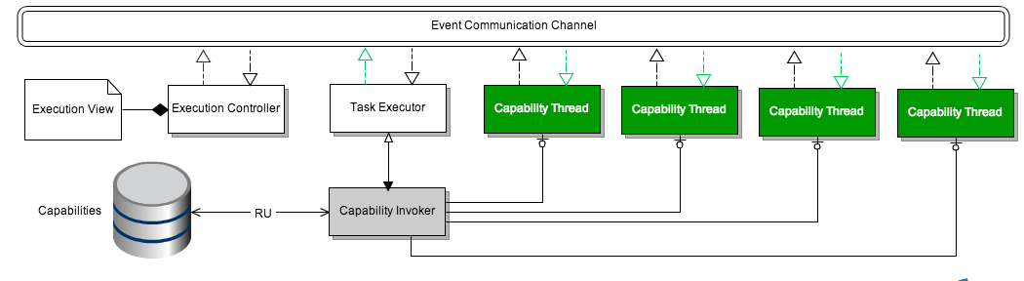

Slide 64
Major Architectural Decisions
Event-based communication
Affects performance and reliability negatively, but promotes interruptability and parallel/sequential task I/O
Flatten the DAG before execution
Improves performance, but loses task context
Use of thread pool
Central location for creating threads, assigning IDs. Improves performance

Slide 65
Major Architectural Decisions Contd.
Singular Task Executor
Decouples user view (separate controller for it) and can manage tasks. Promotes sequential/parallel tasks and I/O, error-reporting as well as interruptibility.
Separate priority queues
To promote interruptibility and reliability(error-handling), but decreases performance due to more polling required
Heartbeat mechanism
To increase reliability of capabilities (error-reporting). This decreases performance

Slide 66
Mapping to business goals
Business Goals
Decisions
Event Based Communication
Flatten the DAG
Thread Pool
Singular Task Executor
Separate priority queues
Heartbeat mechanism
Variety of tasks with I/O
Interrupt a task
Inform user about error
Allow capability addition
Not frustrating (performance)

Slide 67
Mapping to business goals
Business Goals
Decisions
Event Based Communication
Flatten the DAG
Thread Pool
Singular Task Executor
Separate priority queues
Heartbeat mechanism
Variety of tasks with I/O
Interrupt a task
Inform user about error
Allow capability addition
Not frustrating (performance)

Slide 68
Mapping to business goals
Business Goals
Decisions
Event Based Communication
Flatten the DAG
Thread Pool
Singular Task Executor
Separate priority queues
Heartbeat mechanism
Variety of tasks with I/O
Interrupt a task
Inform user about error
Allow capability addition
Not frustrating (performance)

Slide 69
Mapping to business goals
Business Goals
Decisions
Event Based Communication
Flatten the DAG
Thread Pool
Singular Task Executor
Separate priority queues
Heartbeat mechanism
Variety of tasks with I/O
Interrupt a task
Inform user about error
Allow capability addition
Not frustrating (performance)

Slide 70
Mapping to business goals
Business Goals
Decisions
Event Based Communication
Flatten the DAG
Thread Pool
Singular Task Executor
Separate priority queues
Heartbeat mechanism
Variety of tasks with I/O
Interrupt a task
Inform user about error
Allow capability addition
Not frustrating (performance)

Slide 71
Mapping to business goals
Business Goals
Decisions
Event Based Communication
Flatten the DAG
Thread Pool
Singular Task Executor
Separate priority queues
Heartbeat mechanism
Variety of tasks with I/O
Interrupt a task
Inform user about error
Allow capability addition
Not frustrating (performance)

Slide 72
Some Problems with Old Code
Partial and inconsistent implementation of task input
Default input used erratically
It seems to be used as sidecar to get input to capabilities
Many hidden assumptions
Undocumented “oh-by-the-way”s
Abundant use of java reflections and exact method name/type checking, leading very brittle code that is very finicky even about naming conventions within the code
Partial implementation of other (as yet untouched by GizmoE) features, which may or may not introduce further assumptions
TaskReservation
Pausable capabilities
Parallel capabilities are parsed and ‘composed’. Current implementation does not support them
System design had no ‘wait’ for all parallel executions to finish

Slide 73
What’s different in our design?
Features | Gizmo | GizmoE
Sequential w/o Input Output Mapping
Sequential w/ Input Output Mapping
Parallel w/o Input Output Mapping
Parallel w/ Input Output Mapping
Decision-making
Composition
Custom error definition
Web interface
Tasks on CoBot
Custom user inputs
Recomposability
Implemented
Not Implemented
Notes:
Architecture

Slide 74
What’s different in our design?
System was built around the language where as Gizmo task language was built around the system
First built TCL and ensured it had all the features then built the system
Gizmo team was building the system and language in parallel leading to non-compatible features etc.
Using CoBot as a resource
Supports multi- JVMs and tested & demonstrated the same
Custom error definition and user defined input
Gizmo system couldn’t handle errors
Users could define custom errors that would be handled by the GizmoE system
Fully executable sequential and parallel flows
Task re-composability
A user can create a task within a task, to get a meaningful ‘vocabulary’
Enhances what you can do with the system with only a few capabilities
Notes:
Architecture

Slide 75
What’s different in our design?
Well defined I/O from capabilities
Responsibility for handling I/O is clearly stated, and has dedicated components in design
An MVC is implemented along with task execution to get user input
Design-level splitting of task composition and execution
Gizmo team did this while implementing, and design was not focused
Checking of tasks and capabilities at composition
Static analysis (type-checking) along with plug-and-play analysis blocks for Q-learning type analyses
Judicious use of the event bus
Previous design had events going from front-end (task-client) all the way to capability
We converted frontend to all call-return, and used events only to manage capability execution
Notes:
Architecture
Add Gizmo arch table
Put them at the beginning

Slide 76
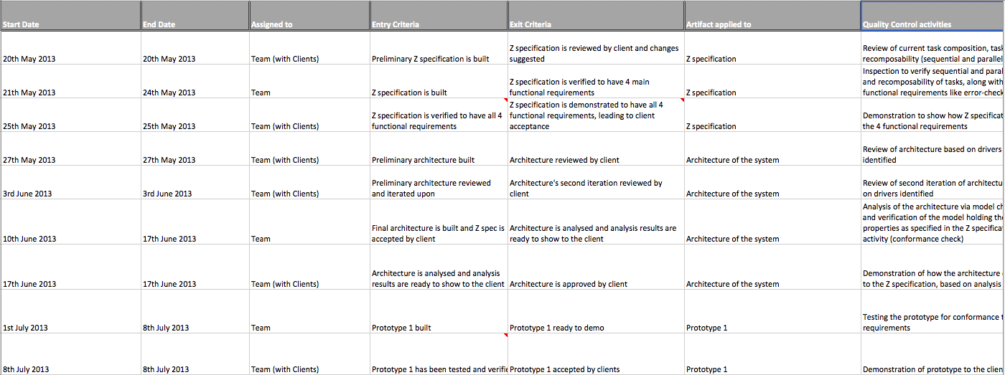
Quality Plan Snapshot

Slide 77
Quality Plan- Old
Answers all 10 quality questions
Quality Activities
Artifacts applied to
When is it done? Who does it?
Entry and exit criteria
Drawn according to milestone plan
Has not been updated with the new milestone plan
Estimates that we will spend around 42% of our time in quality activities in summer
May not have enough time to dedicate
Need to re-work on quality plan

Slide 78
Fit on CoBoT
Capability Spawner (Invoker) has been designed and implemented in a way that it can run on multiple JVMs- Helps in using multiple CoBoTs for executing tasks
Meaningful tasks have been created which simulate the CoBot
Example- Battery Monitor Task
Comprehensive study and documentation on how to use GizmoE system with CoBot
Also explored and documented possible ways to integrate GizmoE with Gizmo
Use GizmoE with no Python code change on CoBot
Notes:
Tried on mock

Slide 79
Lessons Learnt from Gizmo
Notes:
Tried on mock

Slide 80





Tools
Process/Project Management
Source Control
Development Environment

Slide 81
Meet Advisor with Battery Task
Intro
Where we are
How we know
Future Steps
Legend
Success Output Group
Overall Task
Stop Output Group
Task
Inner Task
Capability
Copy Inputs
Input Group
Pipe Inputs
Error Output Group
Stop Outputs
Error Outputs
Parallel Tasks
Parallel Capabilities
Sequential Tasks
Sequential Capabilities

Slide 82
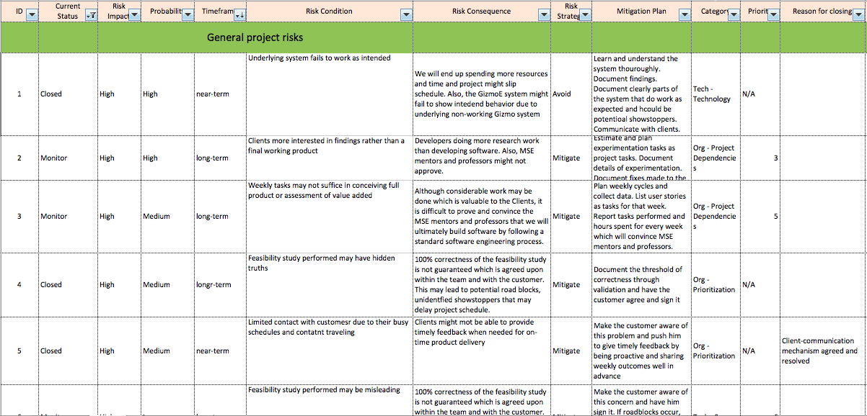
Risk Snapshot

Slide 83
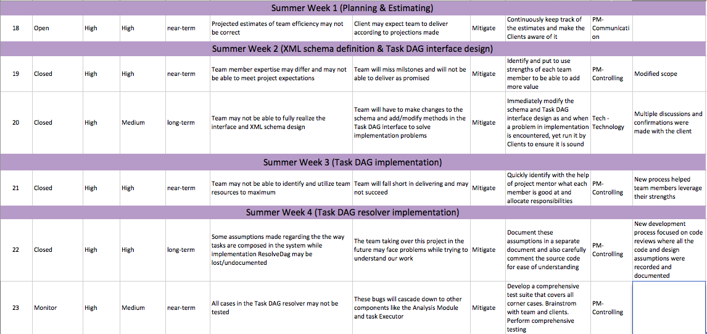
Risk Snapshot 2

Slide 84
Old Backup

Slide 85
Index of Backup
Earned Value – 40
Risk – 42
jBPM – 46
Capability Development – 48
Spike, Spring Break Work – 49
Understanding Gizmo Task System – 51
Problems with Old Code – 53
Z spec – 52
Difference in design – 54
Architecture
Drivers and Views – 56
Runthrough – 59
Decisions and business mapping – 70
Quality Plan – 78
Tools – 80
Context Diagram - 81
Go Back to Index - 39

Slide 86
Flattened Earned Value Chart

Slide 87
Old Earned Value Chart
-15%

Slide 88

Risks – What all is included
ID
Current Status
Risk Impact
Probability
Timeframe
Priority
Risk Condition
Risk Consequence
Risk Strategy
Mitigation Plan
Category
Reason for closing
Action Item

Slide 89
jBPM Feasibility Study 1
jBPM is a business process execution engine present in JBoss Application server
Focused for web-services, although, it can be used for direct class invocation within a Gizmo like web application too
Use the jBPM modeler to create a Business Process
Specify the classes to be called for each node.
Export the process definition file
jBPM will be initialized as a process in Jboss
All classes will be executed as per the workflow. One can specify ANDs/ORs/XORs etc. in the workflow as decision nodes.
This will be done till the END node is hit. There can be multiple END nodes

Slide 90
jBPM Feasibility Study 2
Potential show-stoppers in shifting to jBPM
jBPM doesn’t support parallel tasks, while Clients are interested in parallelism
jPDL doesn’t supporting forking, while the Client’s notion of task composition & execution involves forking [ref]
Tight integration of the Gizmo Execution engine and all components interacting with it could lead to multiple issues in integrating jBPM
There could be/will be multiple thread-safety issues in jBPM. There are multiple assumptions about threads and data between them in the current Gizmo System. In jBPM, these may not hold, leading to major logic changes in the Gizmo System
The current system is on Tomcat. Shifting to jBPM would require shifting to JBoss Application Server. This will impose overhead and could require a lot of time
http://stackoverflow.com/questions/2044926/true-parallel-processing-in-jbpm - ref

Slide 91
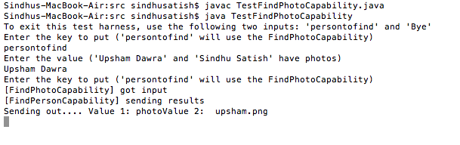
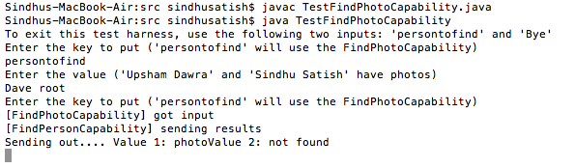
Capability Development
Unit test results

Slide 92
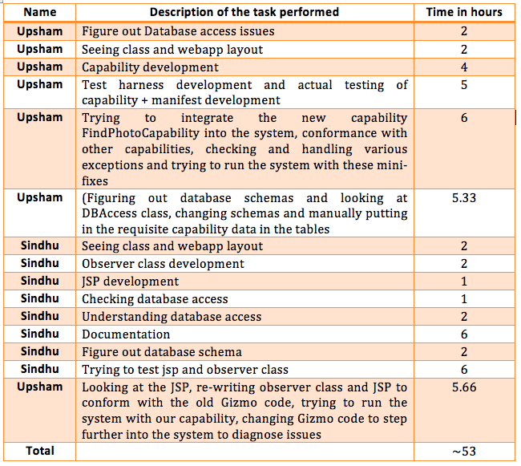
Capability Development - Spike
Task & Time breakdown

Slide 93
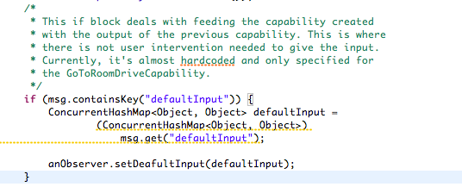
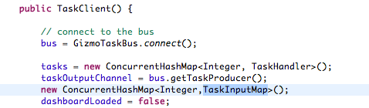
Understanding Task System
Leveraged the knowledge and understanding of other teams analyzing the Gizmo task execution protocol in the Analysis Class
Used Model Checking- Promela, jSpin
Proved that there are discrepancies in the system by highlighting code blocks in documentation

Slide 94
Z Specification
Focus on concept of task and capability
What is a task?
What is a capability?
Special focus on Task I/O
Sequential
Parallel
New Specification has task ‘re-composability’
Task within a task
I/O are ‘collected’ at the beginning and at the end of each task
Connectors include a ‘mux’-like selector, which can either take input from collection or from user
Does not specify error handling still (can have a standard ‘error’ capability plugged always in parallel, or a new default connector like stderr in linux)

Slide 95
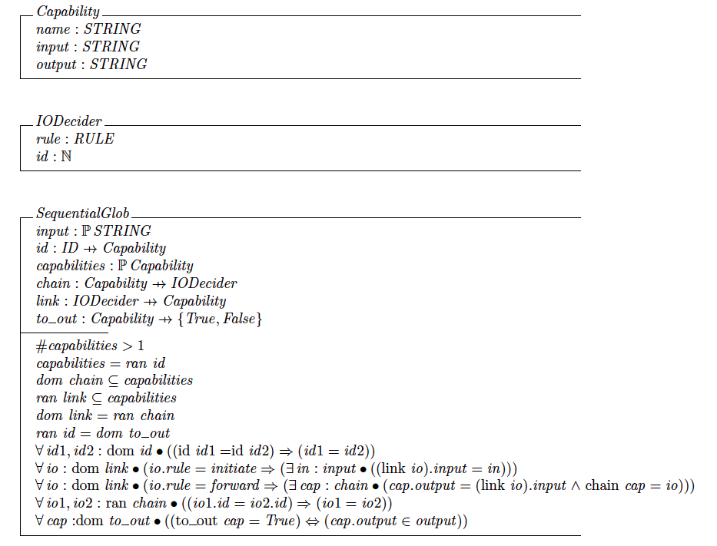
Z Specification - Snapshot

Slide 96



Context Diagram
Executes Tasks
Adds Capability corresponding to
hardware additions
Composes Tasks
Naïve user
Uses CoBot hardware
to execute task
Developer
Adds Hardware to Cobot

